Slide 1

Ecommerce Website for Clothing
Revolutionizing the Fashion Industry

Slide 2
Introduction to Ecommerce
Ecommerce has transformed the way we shop, making it convenient to browse and purchase clothing online. With the rise of online fashion retailers, consumers have access to a wide range of styles and trends at their fingertips.

Slide 3
Market Trends in Clothing Ecommerce
The clothing ecommerce market is experiencing rapid growth, fueled by factors such as increasing internet penetration, changing consumer preferences, and advancements in technology. Online fashion sales are projected to continue rising, with more consumers opting to shop for clothing online.

Slide 4

Importance of a User-Friendly Website
A user-friendly website is essential for a successful clothing ecommerce business. It should offer easy navigation, high-quality images, detailed product descriptions, and a seamless checkout process to enhance the shopping experience.

Slide 5
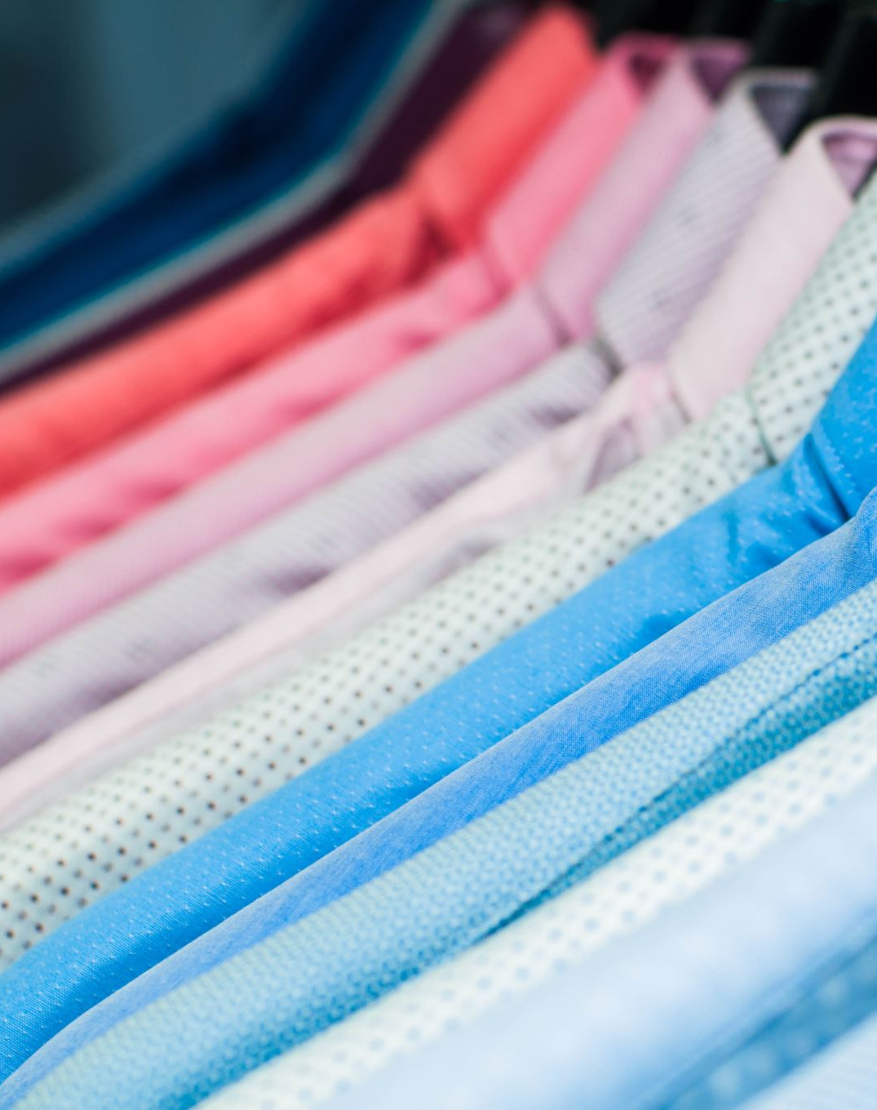
Design and Branding
The design and branding of your ecommerce website play a crucial role in attracting and retaining customers. Your website should reflect your brand identity through its layout, color scheme, typography, and imagery.

Slide 6
Product Showcase
Highlight your clothing products through stunning visuals and compelling descriptions. Use high-resolution images and videos to showcase the details of each garment, and provide sizing charts and fit guides to help customers make informed purchases.

Slide 7

Seamless Checkout Experience
A seamless checkout experience is essential for reducing cart abandonment and increasing conversions. Simplify the checkout process by offering multiple payment options, guest checkout, and one-click purchasing.

Slide 8

Customer Engagement and Support
Engage with your customers through personalized recommendations, email marketing, and social media promotions. Provide excellent customer support through live chat, email, and phone to address any queries or concerns.

Slide 9
Marketing Strategies
Implement various marketing strategies to drive traffic to your clothing ecommerce website. Utilize search engine optimization (SEO), social media advertising, influencer collaborations, and content marketing to reach your target audience.

Slide 10

Conclusion and Next Steps
In conclusion, an ecommerce website for clothing presents a lucrative opportunity in the fashion industry. By creating a user-friendly website, showcasing your products effectively, and implementing robust marketing strategies, you can establish a successful online clothing store. The next steps involve continuous monitoring and optimization to enhance the shopping experience and drive growth in sales.

